Slide 1

REV UP MA September 2026 Meeting
Thursday, September 24, 2026
1 PM – 2 PM
Zoom

Slide 2
Housekeeping & Accessibility

Slide 3
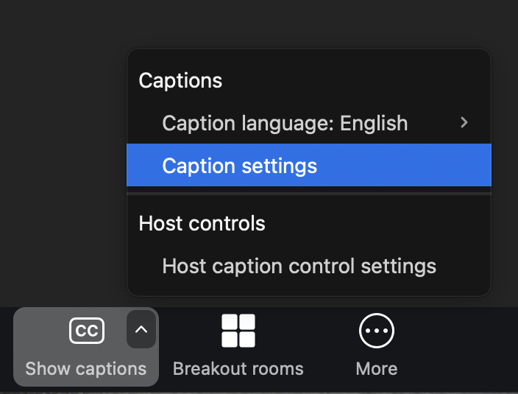
Accessibility
Keep chat use to a minimum if you are able
Captioning: CART Captioner Denise is providing captions
  To view captions: Click the ‘CC’ or ‘Show Captions’ button at the bottom of your Zoom screen (it may also be under the ‘More’ button depending on your device.)
  To adjust font size and color: click the carrot or ‘up’ arrow ^ and ‘Caption Settings.’
  Streamtext link provided in chat

Slide 4
Accessibility, continued
ASL interpreters will be spotlit/readily visible on your screen while they interpreting.
  In case of tech issues, you can pin the interpreters on your screen by clicking the three dots on the right of the ASL interpreters’ screens and pressing ‘Pin.’
  If you hear the ASL interpreters speak, they are interpreting for someone who is speaking ASL.
Please let us know if you have any issues with accessing CART captions or viewing ASL interpreters!

Slide 5
Any other access needs?
Feel free to speak up or message Brianna in the chat!

Slide 6
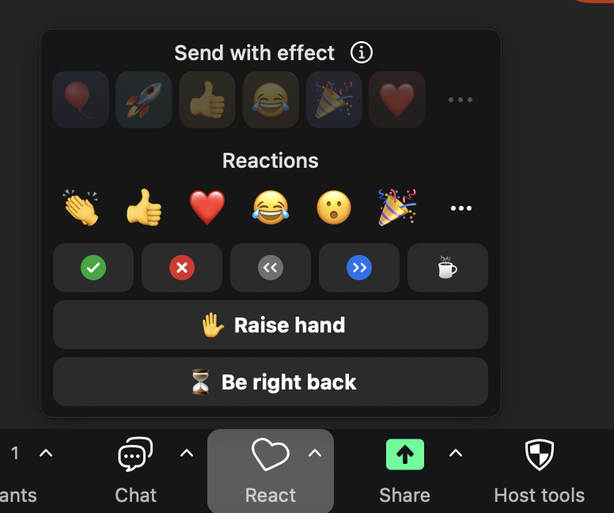
Housekeeping
Say your name before you speak.
Use the raise hand feature by clicking the ‘Reactions’ and ‘Raise hand’ buttons at the bottom of your screen. If you are joining by phone, dial *9 to raise and lower your hand.
Mute/unmute by pressing the microphone button at the bottom left of your screen. If joining by phone, dial *6 to unmute/mute yourself.

Slide 7
Today’s Agenda

Slide 8
Today’s Meeting Agenda
Skipping Introductions – say your name and organization when you speak or in the chat
Intro to REV UP MA (if new members) (2 minutes)
Debrief on Primary Election: Voting Experiences, Accessibility Issues, etc. (10 – 15 minutes)
Debrief on Disability Voting Rights Week Events (10 – 15 minutes)
Accessible Voting Equipment Fair Feedback (10 – 15 minutes)
Important Dates (2 minutes)
Planning Ahead: Future events and advocacy (last 5 – 10 minutes)

Slide 9
Introduction to REV UP MA
REV UP stands for “Register, Educate, Vote, Use your power!”
REV UP MA is a statewide coalition of organizations and individuals. We:
  Educate people with disabilities about voting rights
  Advocate for accessible voting processes
  Help people with disabilities to register to vote
  Encourage civic engagement of people with disabilities
Learn more: visit REV UP MA’s website and sign up for our email list!

Slide 10
Primary Election Debrief
Disability Law Center learned about:
  Parking issues
  Locked accessible entrances
  Heavy doors
  AutoMARK not being set up, lack of awareness of the AutoMARK
  Lack of signage directing people to accessible entrances
What were your voting experiences like? Did you encounter any issues?
  You can share your experiences by filling out DLC’s short survey

Slide 11
Polling Place Accessibility Surveys
Are you interested in conducting polling place accessibility survey? If so, do you know where you want to survey and if you are interested in teaming up with other members?
  Contact bzimmerman@dlc-ma.org to let us know!
Check out the full polling place accessibility survey
Watch the recorded polling place accessibility survey training

Slide 12
Disability Voting Rights Week Events
Empowering Every Voter event with Massachusetts West Region Self-Advocacy in Chicopee (9/8)
REV UP the Disability Vote webinar with the Arc of Massachusetts (9/17)
  Recorded and posted to YouTube
The Caring Force Western MA Disability Voting Rights Week and Direct-Support Professionals Recognition Week Celebration in Westfield (9/18)
Get Out the Vote Table at Danehy Park Family Day in Cambridge (9/19)
Any other events or ways that you celebrated Disability Voting Rights Week?

Slide 13
Accessible Voting Equipment Vendor Fairs (August 10 – 14)
Fairs took place in Middleton, Northampton, Brockton, Watertown, and Worcester
Four vendors participated: DemocracyLive with OmniBallot Tablet, ES&S with AutoMARK 2, LHS with Dominion ImageCast X BMD, and Smartmatic
Over 200 attendees

Slide 14
Secretary of State’s Office Seeking Feedback on Accessible Voting Equipment
From the Secretary of State’s office: Here are questions that we would like to learn more from you about the accessible voting options presented at the fairs.
Which vendor fair did you attend?
What brought you to the vendor fair? How did you hear about us?
Have you used accessible election equipment prior attending the 2026 vendor fair?
After reviewing the options at the fair, which equipment did you like best and why?
Which equipment did you least like and why?
Any additional comments?

Slide 15
Send Feedback to the Secretary of State’s Office
Send your feedback to the Secretary of State’s office Project Manager Bridget Simmons Murphy
  Email: bridget.murphy@sec.state.ma.us
Let us know if you share feedback (email info@revupma.org)

Slide 16
Important Dates
Voter Registration Deadline:
Saturday, October 24
Vote by Mail Application Deadline:
Tuesday, October 27 by 5 PM
Early Voting Period:
Saturday, October 17 – Friday, October 30
Election Day:
Tuesday, November 3 (polls open 7 AM – 8 PM)

Slide 17
Wrapping Up

Slide 18
Planning Ahead
Discussion of next steps/action items
Continued advocacy on accessible voting machines
  Advocate for accessible voting equipment to be rolled out soon: ideally for 2028 elections. (All)
  Op-ed on the importance of accessible voting equipment (Commonwealth Beacon?)
  Submit your feedback on equipment to Bridget Simmons Murphy (all)
  Invite Secretary’s office to upcoming meetings (BZ can invite)

Slide 19
Planning Ahead, Continued
Polling Place Accessibility
  Draft materials for contacting local election office with issues (Brianna, Kay)
  Let Brianna (bzimmerman@dlc-ma.org) know if you want to get involved in polling place accessibility surveys (all)
Sharing future events
  If you are holding future events such as voter registration drives, candidate forums, trainings, etc. share information with info@revupma.org or bzimmerman@dlc-ma.org. We can share with our email list/social media.
  Can share info to the national dashboard: https://www.mobilize.us/rev-up-aapd/c/dvrw-2026/event/create/

Slide 20
Upcoming Meetings
Sign up for our next meetings (if you didn’t already!)
  Thursday October 15 at 11 AM

Slide 21
Sign up for REV UP MA emails & check out our website!
For upcoming meeting/event information, voting advocacy updates, and resources…
Sign up for REV UP MA emails!
Check out our website

Slide 22
Brianna’s Contact Information
Brianna Zimmerman (She/Her/Hers)
Voting Rights Advocate
Disability Law Center, Inc.
Direct phone/fax/text: 617-315-4593

