Slide 1

REV UP MA June 2026 Meeting
Thursday, June 18, 2026
1:00 – 2:00 PM
Zoom

Slide 2
Housekeeping & Accessibility

Slide 3
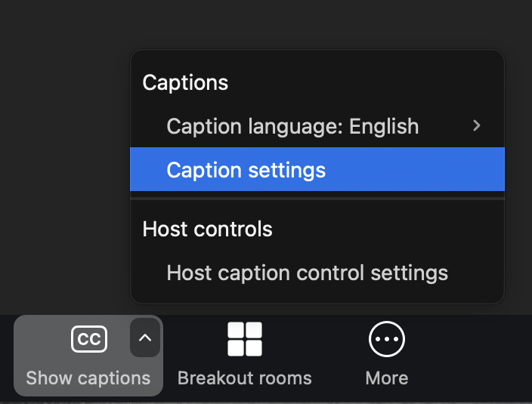
Accessibility
Keep chat use to a minimum if you are able
Captioning: CART Captioner providing captions
  To view captions: Click the ‘CC’ or ‘Show Captions’ button at the bottom of your Zoom screen (it may also be under the ‘More’ button depending on your device.)
  To adjust font size and color: click the carrot or ‘up’ arrow ^ and ‘Caption Settings.’

Slide 4
Accessibility, continued
ASL interpreters will be spotlit/readily visible on your screen while they interpreting.
  In case of tech issues, you can pin the interpreters on your screen by clicking the three dots on the right of the ASL interpreters’ screens and pressing ‘Pin.’
  If you hear the ASL interpreters speak, they are interpreting for someone who is speaking ASL.
Please let us know if you have any issues with accessing CART captions or viewing ASL interpreters!

Slide 5
Any other access needs?
Feel free to speak up or message Brianna in the chat!

Slide 6
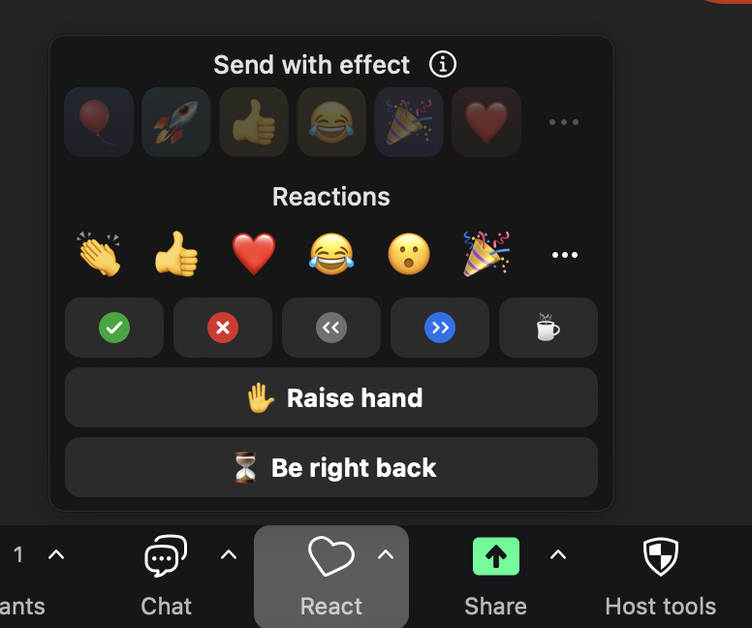
Housekeeping
Say your name before you speak.
Using the raise hand feature
  Use the raise hand feature by clicking the ‘Reactions’ and ‘Raise hand’ buttons at the bottom of your screen. If you are joining by phone, dial *9 to raise and lower your hand.
Mute/unmute by pressing the microphone button at the bottom left of your screen. If joining by phone, dial *6 to unmute/mute yourself.

Slide 7
Today’s Agenda

Slide 8
Today’s Meeting Agenda
Getting started, Introductions (5 – 10 minutes)
  Housekeeping and accessibility (done)
  Review Agenda
  Introductions / Icebreaker
Introduction to REV UP MA (if new members) (2 minutes)
Brief Review of Goals (5 minutes)
Debrief on Rev Up the Vote Webinar (5 – 10 minutes)
Other Outreach and Advocacy Updates (10 – 15 minutes)
Coordinating Plans and Workgroups for Summer/Fall 2026 (20 – 25 minutes)
  Voter registration drives
  Polling place accessibility surveys
  New member recruitment

Slide 9
Introductions & Icebreaker
Introduction
Name
Pronouns
Location
Organization (if applicable)
Icebreaker
Are there any Summer plans you are looking forward to? (Could be work or non-work related!)

Slide 10
Introduction to REV UP MA
REV UP stands for “Register, Educate, Vote, Use your power!”
REV UP MA is a statewide coalition of organizations and individuals. We:
  Educate people with disabilities about voting rights
  Advocate for accessible voting processes
  Help people with disabilities to register to vote
  Encourage civic engagement of people with disabilities
Learn more: visit REV UP MA’s website and sign up for our email list!

Slide 11
Review of REV UP MA 2026 Goals

Slide 12
Goals
AutoMARK advocacy on new accessible voting machines
Survey polling places for accessibility issues
Voter Education
Voter Registration (register at least 50 voters)

Slide 13
Rev Up the Vote Webinar 2026
Presentations by Disability Law Center
  Voter registration
  Accessible remote voting at home and in facilities
  Accessible in-person voting
  Volunteer opportunities
Our goal was to empower people to take away information they can use in their everyday work/lives; get people thinking about how they can register, empower, and educate people with disabilities to vote
  If you are doing voter registration work, we want to know about it! Contact Brianna so that we can measure REV UP members’ impacts and report it to our national partners.
  We can list your organization as a member on REV UP MA website.
Webinar recording
Feedback survey

Slide 14
Outreach and Advocacy Updates
DLC: Voting-Related Updates and Events
NASW-MA Older Adults and People with Disabilities conference on June 11: Empowering the Disability Vote: A Guide for Social Workers (Continuing Education Units available)
Brandeis Disabled Students Network #CripTheVote event
National connections with National Disability Rights Network, REV UP national, REV UP VT and ME
Massachusetts West Region Self-Advocacy Conference (Springfield)
Older Adult Behavioral Health Network (Worcester)
Various other outreaches

Slide 15
Upcoming Events: ADA Celebrations
ADA Day at Dunn State Park:
Friday, July 31st, 2026
11am – 3:00 pm
Dunn State Park
289 Pearl Street, Gardner, MA 01440
Rain or Shine!
Boston ADA Day:
Wednesday, July 15, 2026
12 PM – 2 PM
560 Boylston St., Boston
*DLC will be tabling, REV UP represented
Stavros Rock, Roll and Stroll Event:
Saturday, July 25, 2026
2 PM – 6 PM
Look Memorial Park, Northampton
*DLC will be tabling, REV UP represented

Slide 16
Upcoming Events, Continued
DLC Community Conversations (next slide)
Independent Living (IL) Conference
Best Western, Marlborough
Wednesday September 23, 2026
8:30 AM – 3:30 PM
Upcoming voter registration plans with Stavros and AdLib Centers for Independent Living

Slide 17
DLC Focus Area Community Forums
Each year, DLC asks the disability community about the legal issues that matter most (including voting-related issues).
DLC will be holding three community conversations this year. CART and ASL have been requested for all events.
  Boston: Wednesday, June 24
  10 am - 12 pm
  Brockton: Thursday, June 25
  10am - 12 pm
  Online: Wednesday, July 8
  6:30 pm - 8 pm
  Virtual – participate from anywhere!
Learn more and register for community conversations on DLC’s website.

Slide 18
Wrapping Up

Slide 19
Action Items and Next Steps
Brianna & All: Set up voter registration group meeting next month
Brianna: AutoMARK advocacy
  Contact national partners regarding which states have sip-and-puff capabilities with voting machines.
  Share information about upcoming equipment fairs that Secretary of State is organizing, when available.
  Report back.
Brianna and Sue: We will share Summer event information (ADA celebration events)
All: Member recruitment
  Contact Brianna with any additional groups who might be interested in joining REV UP MA, more diversity needed

Slide 20
Sign up for REV UP MA emails & check out our website!
For upcoming meeting/event information, voting advocacy updates, and resources…
Sign up for REV UP MA emails!
Check out our website

Slide 21
Brianna’s Contact Information
Brianna Zimmerman (She/Her/Hers)
Voting Rights Advocate
Disability Law Center, Inc.
Direct phone/fax/text: 617-315-4593

