Slide 1
How To Survey a Polling Place for Accessibility
Disability Law Center
Emily Almeda-Lopez
Voting Rights Advocate
Thomas Murphy
Supervising Attorney

Slide 2
What is DLC?
DLC is a nonprofit legal services organization that also serves as the designated Protection and Advocacy (P&A) agency for Massachusetts.
DLC provides legal advocacy on disability issues and promotes the fundamental rights of all individuals with disabilities to participate fully in the social and economic life of Massachusetts.

Slide 3
What is a P&A?
It is a federally mandated system and exists is every state and territory and one Native American consortium.
P&As provide legally based services through the protection of rights and advocacy for appropriate services for individuals with disabilities.
P&As have several different federal ‘programs,’ each with a specific focus.
Voting Rights for people with disabilities is one major focus.

Slide 4
Relevant laws: The ADA
The ADA requires that public entities ensure that people with disabilities can
access and use all of their voting facilities.
Ensuring access can include temporary measures, but “the use of temporary measures to provide access to polling places on Election Day does not change a public entity’s obligations under the ADA to ensure that its other programs and services are accessible to people with disabilities, nor does it mean that a temporary remedy would be appropriate in a public facility on an everyday basis.”

Slide 5
Relevant laws: HAVA
The voting system shall:
(A) Be accessible for all individuals with disabilities, including nonvisual accessibility for the blind and visually impaired, in a manner that provides the same opportunity for access and participation (including privacy and independence) as for other voters;
(B) Satisfy the requirement of subparagraph (A) through the use of at least one direct recording electronic voting system or other voting system equipped for individuals with disabilities at each polling place

Slide 6
Polling Place Surveying
You don't need to be an accessibility "expert."
Think through all of the steps that you go through when you vote.
Parking
Pathway to polling place
Entrance
Interior route
Voting area
Voting equipment
Exit

Slide 7
Parking Lot
Does the parking lot meet the minimum number of HP spots required? 1 per 25
Are there visible elevated signs (5-8' high) and ground markings indicating HP spots?
The HP spaces are 8 feet wide and have an adjacent 4 foot access aisle
Parking area clear and reasonably lit; flat; clear of gravel, mud, etc.
If no parking lot is available, there is at least one on-street parking space which is at least temporarily designated as a handicapped parking space during the election in front of the polling place.
Look for adequate designation, signage to polling place, path of travel
Keep in mind: The polling place entrance may not be the main entrance to the building
Accessible parking may be far from polling place entrance
Is there an accessible drop-off area?
Is temporary parking in closer proximity necessary?

Slide 8
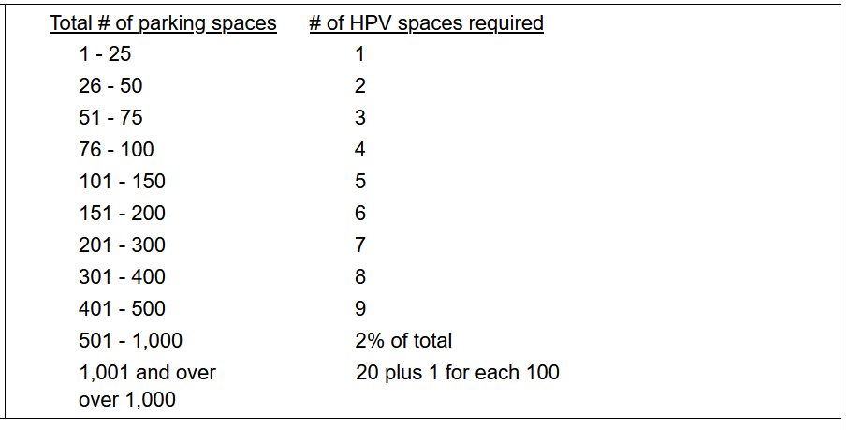
Ratio of HP parking
Notes:
Basically it's 1 Handicap Parking space for every additional 25 spaces in a parking lot. So 25 spaces and under only needs 1, 26-50 needs 2, 51-75 needs 3 etc

Slide 9
Pathways/Sidewalk
Curb ramps: at least 36" wide; slope no more than 1:12
Stable slip resistant surfaces like concrete or asphalt
No gaps greater than 1/2 inch in any surface in direction of travel to prevent castors and canes getting stuck
No sudden drops greater than 1/4th inch in a pathway, ½ inch if beveled/sloped
Path to accessible entrance clearly marked and well-lit if needed
Accessible route is at least 36" wide
The path of travel is the same or a substantially similar distance for all persons entering the polling place
If applicable: Public transportation route to entrance

Slide 10
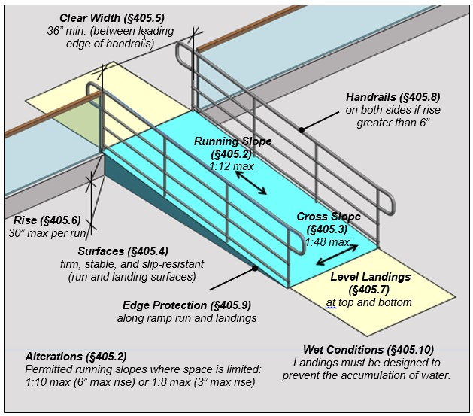
Ramps
1/12 slope (Can measure rise/run via tape measure)
Handrails
One or more stops/platforms for longer ramps
The ramp is at least 48 inches wide.
If the ramp is portable, it is as close to 1:12 (8.3%) as possible, and either handrails or wheel guards at least two inches high on both sides are provided.

Slide 11
Entrances
Lever handles or other accessible hardware are provided on doors, so that they may be operated with a closed fist.
Avoid necessity for tight grasping, pinching or twisting.
Doorways are at least 32 inches clear width. Door thresholds are no higher than ½ inch above the floor.
Door opening force
Does a door need to be propped open? Should a poll worker be assigned?
If the main entrance is not accessible, signs direct people to the accessible entrance.
If the accessible entrance is not the main one, it is unlocked and able to be used without assistance during the same hours as the main entrance.

Slide 12
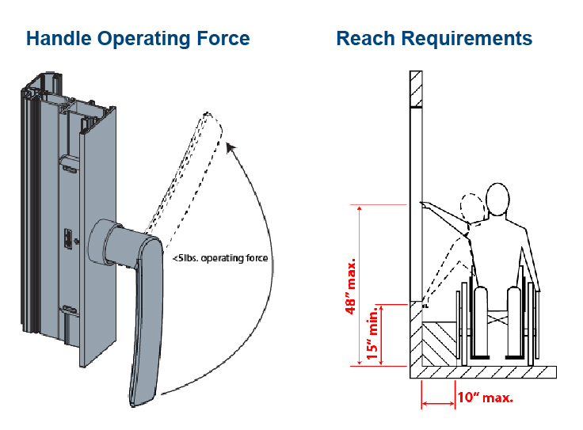
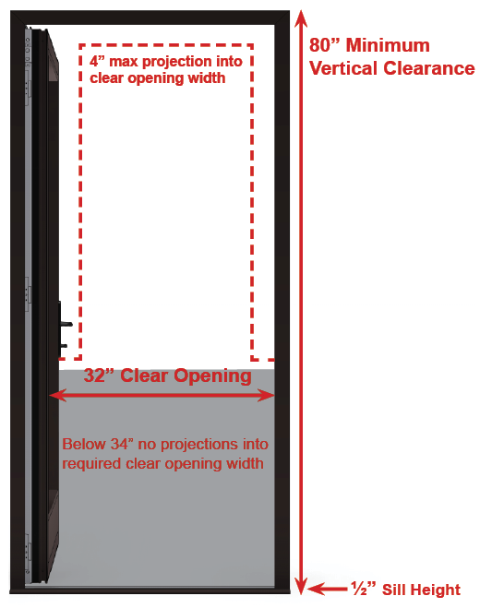
Entrances: Visual Examples of accessible entrance.

Slide 13
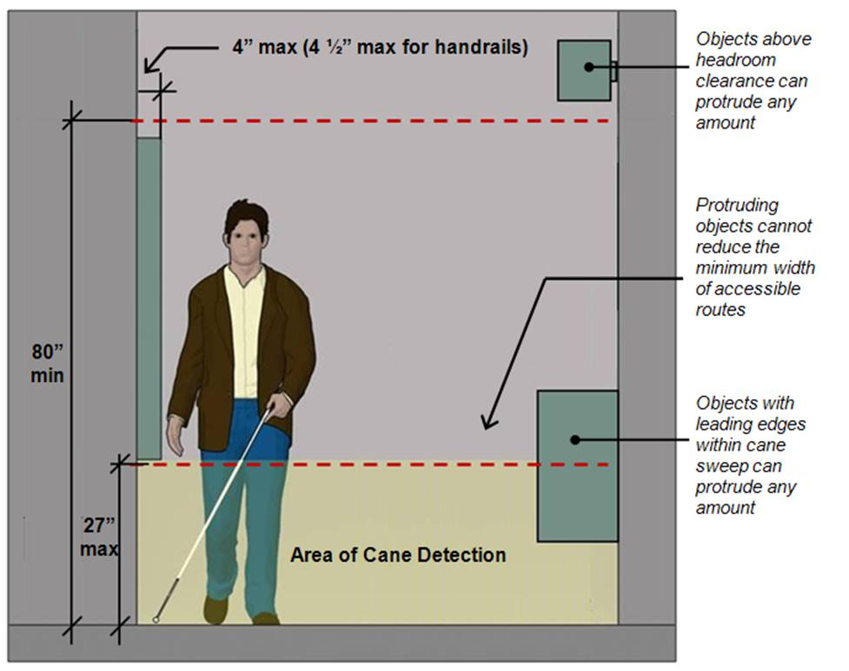
Interior
Does the accessible route have an area that’s at least 48 inches wide which can be used for turnaround space?
Is the route free of obstructions and at least 36" wide and the same as the one used by the public?
Does the interior comply with other accessibility standards for ramps if steps or slope greater than 1:20?

Slide 14
Accessible Route
Look for obstructions, protruding objects, etc.:
Drinking fountains
Coat racks
Fire extinguishers
Display cases
Open staircases
Use cones or other warning barriers that can be detected with a cane.
If accessible route is different, is there adequate directional signage?

Slide 15
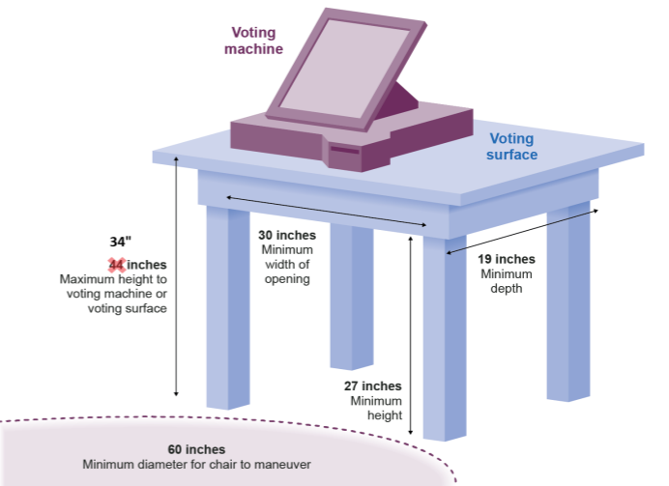
Voting Area
48 inches wide turnaround space
Can person with mobility impairment move about freely?
At least one accessible voting machine
Table/station at height to accommodate wheelchair user
Clear signage directs voter to poll station
No protruding objects; see last slide
Place to sit for people waiting

Slide 16
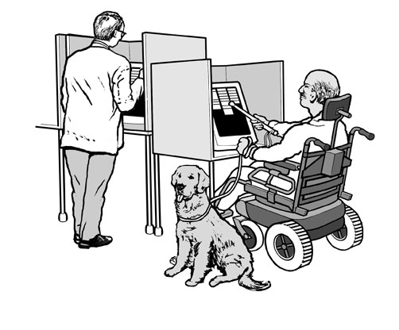
Voting Equipment
All Polls – A sample ballot has been posted on the wall no higher than 48 inches above the floor.
Paper ballots – At least one marking shelf provides a clear space under it at least 30 inches wide, at least 27 inches clear to the underside, and no more than 32 inches high to the top.
Voting Machines – At least one machine has a sample ballot posted inside, not higher than 48 inches.
Voting levers are no higher than 48 inches above the floor, or a “reacher” is available for the upper levels.

Slide 17
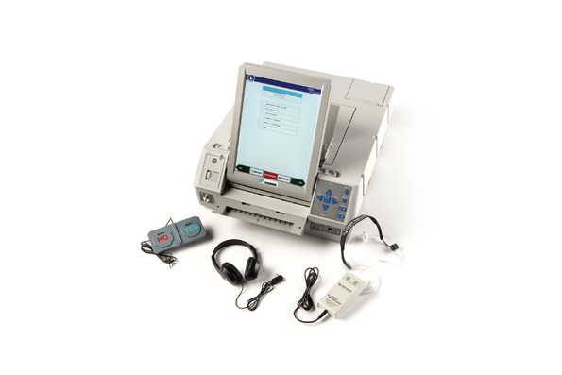
Accessible Voting Equipment
There is at least one AutoMARK machine that is readily available and accessible for use by voters.
Staff have been trained on the AutoMARK machine and understand who may use the machine (anyone can ask to use it).
An AutoMARK privacy shield is available for use.
The location of the AutoMARK machine affords the voter the same privacy that non-disabled voters are afforded.

Slide 18
Reasonable Accommodation
Modify voting policies, practices, or procedures when such modifications are necessary to avoid discrimination on the basis of a voter’s disability.
Allow a voter with a disability to sit down instead of stand in a long line to vote.
Allow a voter with a disability to bring a service animal into the polling place even if the location has a no-pets policy. Learn more about service animals.
Allow a voter with a disability who needs assistance to have their companion with them in the voting booth.

Slide 19
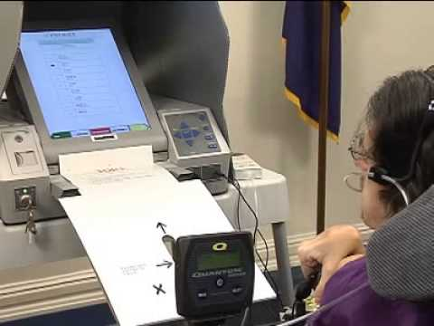
How to Use the Automark Machine

Slide 20
Things to remember when surveying
Do not take pictures of people at the polls.
Check in with the head of the polling place before you start your survey.
If you take a picture of an issue, try and get pictures from multiple angles and make sure they are of decent quality
Take notes of everything relevant you observe to submit via the online survey after
If there is any sort of time sensitive accessibility issue please notify the Secretary of the Commonwealth's Office at: 1-800-462-8683 and call me at: (617) 221-8451

Slide 21
Tools You Will Need
A retractable metal tape measure;
A phone, camera or other way to take pictures;
Optional: A copy of the ADA polling site checklist;
Optional: A digital or bubble level and a door pressure gauge
A way to take notes on polling sites you survey

Slide 22
How to use the online survey
https://www.dlc-ma.org/polling-place-grassroots-survey/ click this link on a tablet or phone and follow the directions, starting from the outside/parking lot and working your way in.

Slide 23
Quick fixes
Doors can be wedged open for the duration of use as a polling place
Signs and traffic cones can be used to make temporary accessible parking
Temporary signs can direct voters to accessible routes
Temporary ramps are an acceptable stopgap measure for entrances that need them
Paper or cardboard can be used to improvise privacy shields

Slide 24
Questions?

Slide 25
Contact Me
Emily Almeda-Lopez
Email: Ealmedalopez@DLC-MA.org
Phone Number: (617) 221-8451

